Slide 1
Final Project Part A
Group:7
Members: Chi-Hao Tseng, Hanyu Li, Raghul Balamurugan, Shubhangkar Girish Jain, Tanvi Mehra

Slide 2
"We pledge on our honor that we have not given nor received any unauthorized assistance on this assignment with other groups.”
- Chi-Hao Tseng, Hanyu Li, Raghul Pandi, Shubhangkar Girish Jain, Tanvi Mehra.

Slide 3
CONTENTS
Creating the Portfolio
Mean Variance Optimization and Best Portfolio Sharpe
Comparison of Equal-Weighted And Maximum Sharpe Portfolio
Beta Calculation
Portfolio Comparison and Summary Statistics

Slide 4
GUIDING PRINCIPLES
MISSION
VISION
To ensure the created portfolio has the highest sharpe and maximise our clients investment
To be the most trusted wealth management firm and ensure financial well being for our customers.

Slide 5
CREATING THE PORTFOLIO

Slide 6
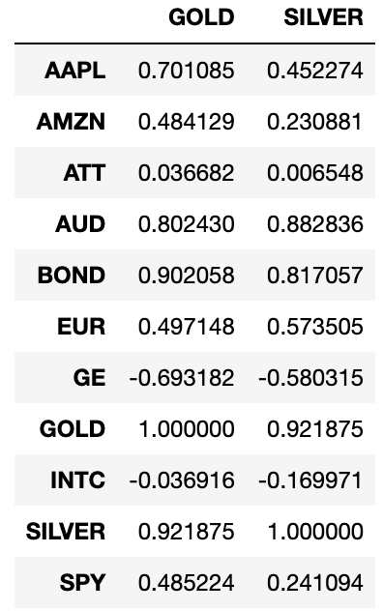
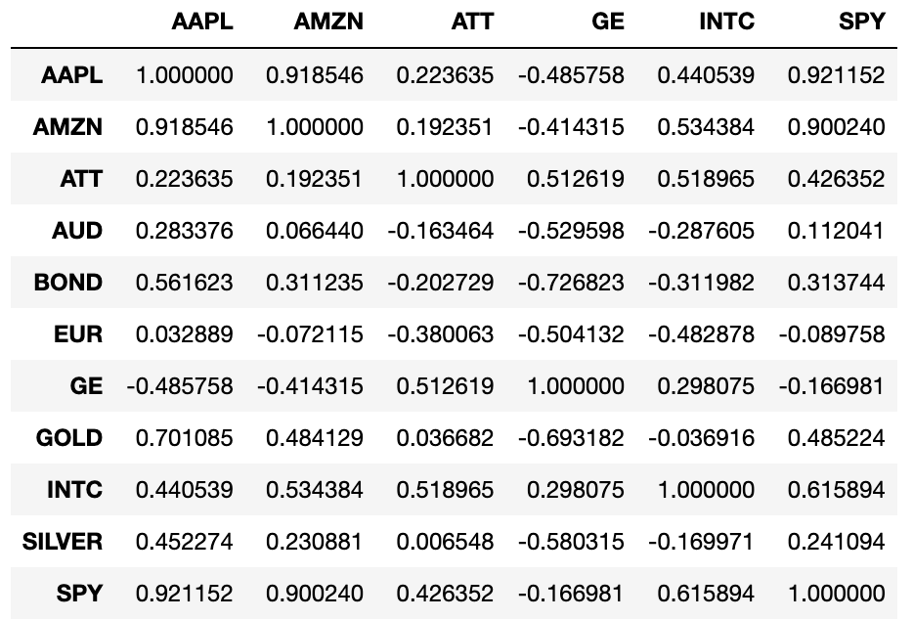
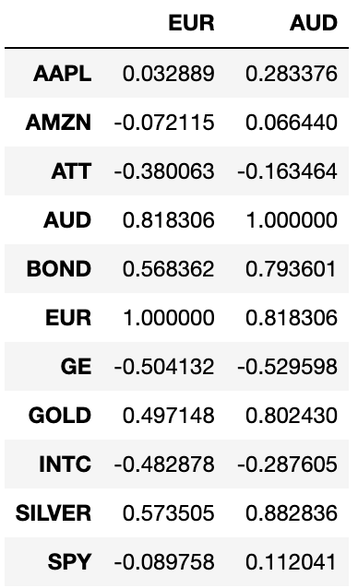
FACTORS CONSIDERED FOR CHOOSING PORTFOLIO
CORRELATION

Slide 7
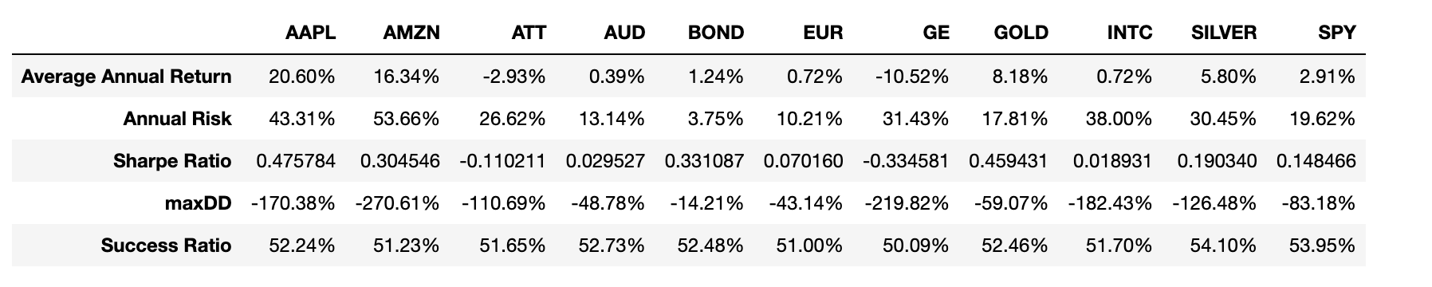
FACTORS CONSIDERED FOR CHOOSING PORTFOLIO
SHARPE RATIO

Slide 8
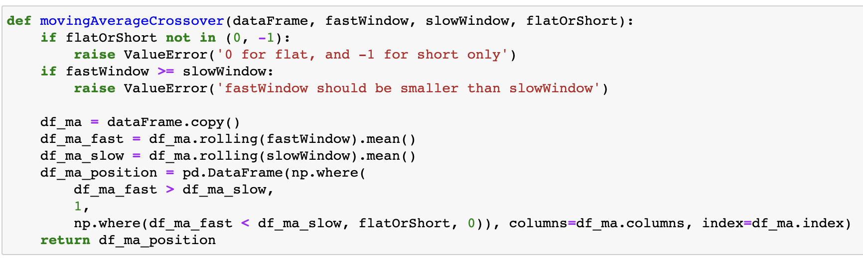
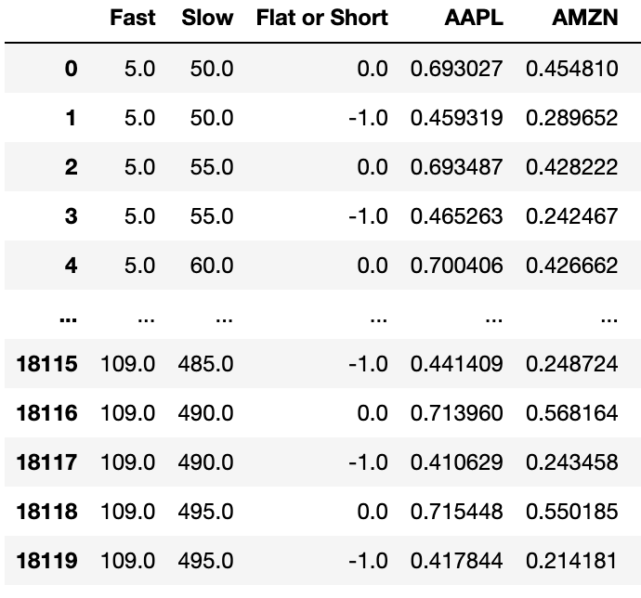
MOVING AVERAGE CROSSOVER STRATEGY

Slide 9
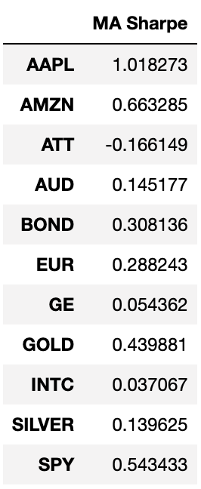
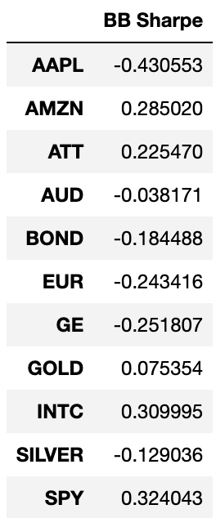
MA STRATEGY & BB STRATEGY RESULTS

Slide 10
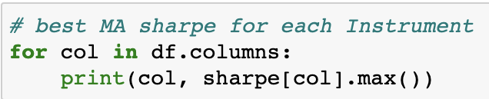
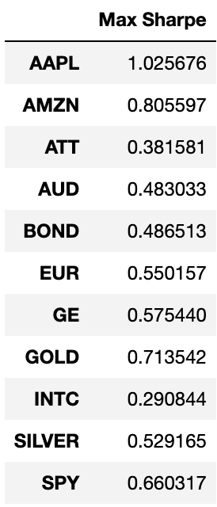
FINDING BEST MA CROSSOVER STRATEGY
Listed out the best sharpe for each instrument.
Since AAPL had the highest sharpe, started using that as our reference.
Hence, will identify the windows where AAPL had the highest sharpe and finalize our fast and slow windows.

Slide 11
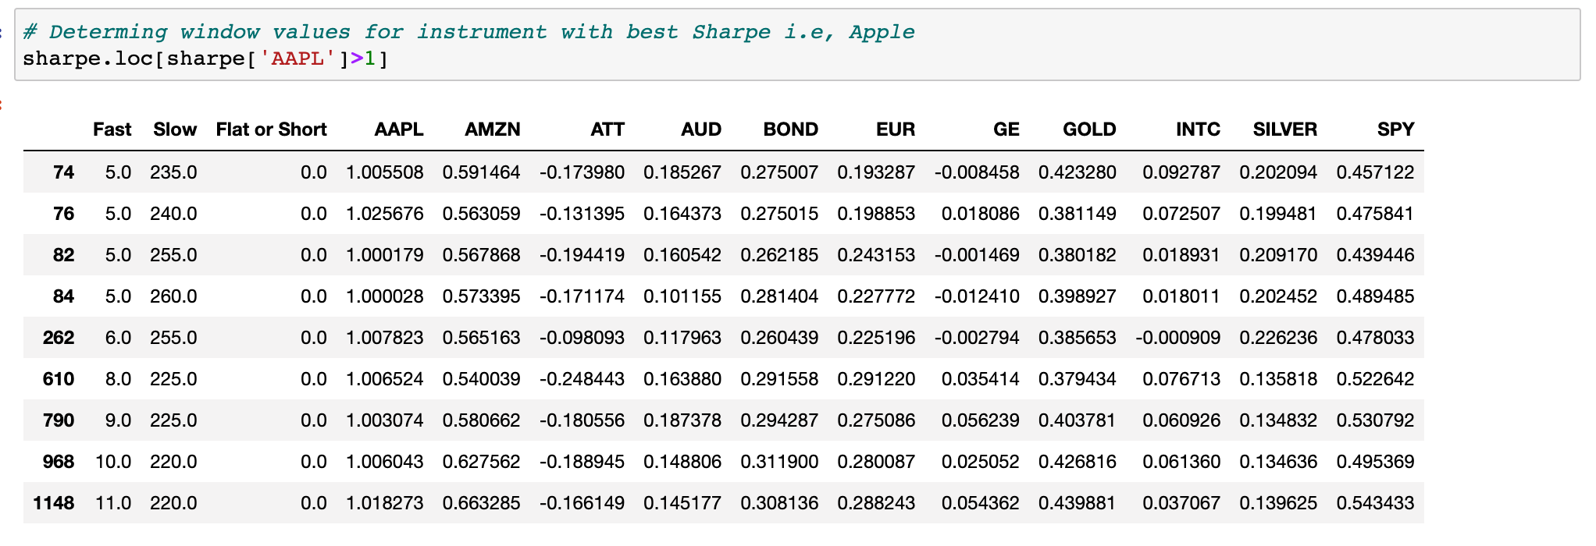
FINDING BEST MA CROSSOVER STRATEGY

Slide 12
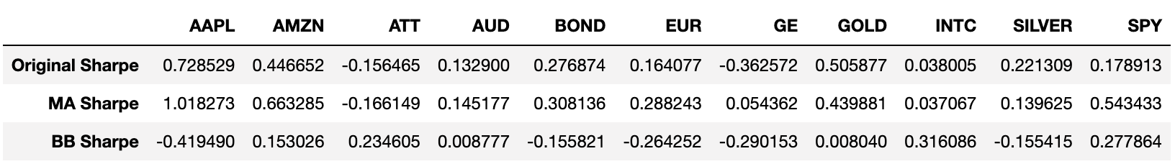
PORTFOLIO DECISION
Equity: AAPL, AMZN, ATT, INTC, SPY
Fixed Income: BOND
Commodity: GOLD
Currency: EUR-USD

Slide 13
MEAN VARIANCE OPTIMIZATION AND BEST PORTFOLIO SHARPE

Slide 14
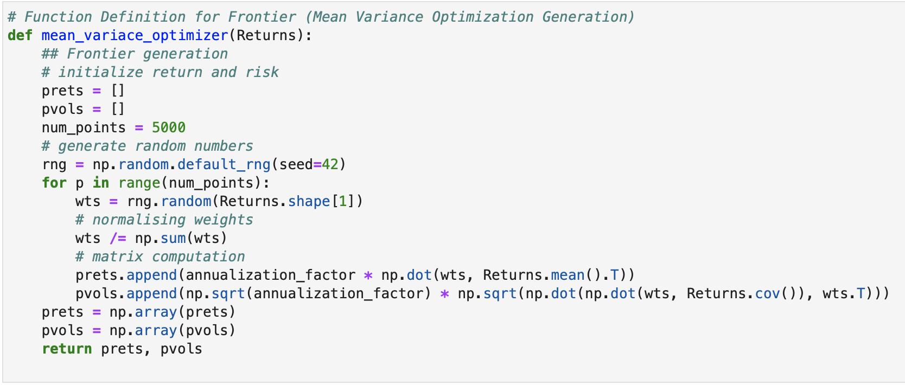
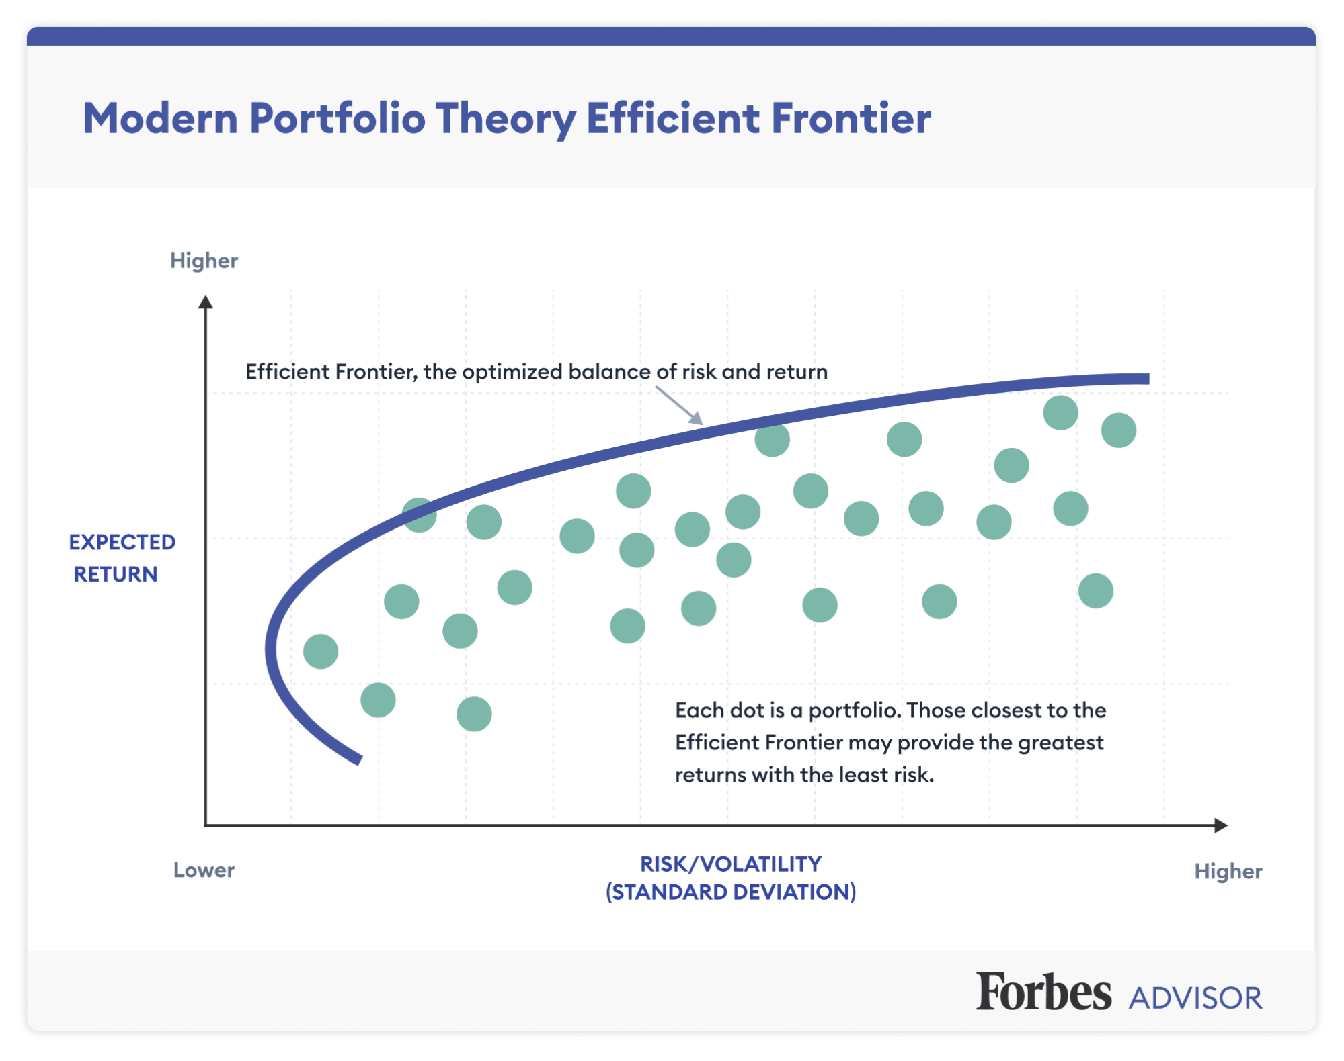
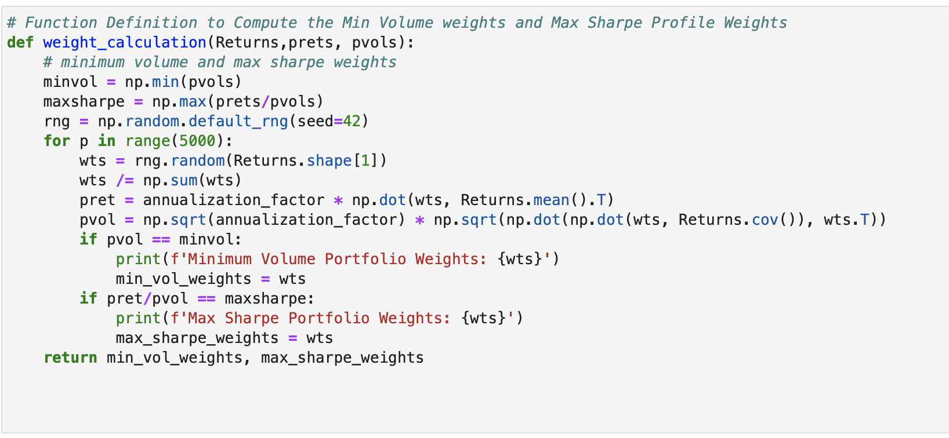
MEAN VARIANCE OPTIMIZATION - EFFICIENT FRONTIER

Slide 15
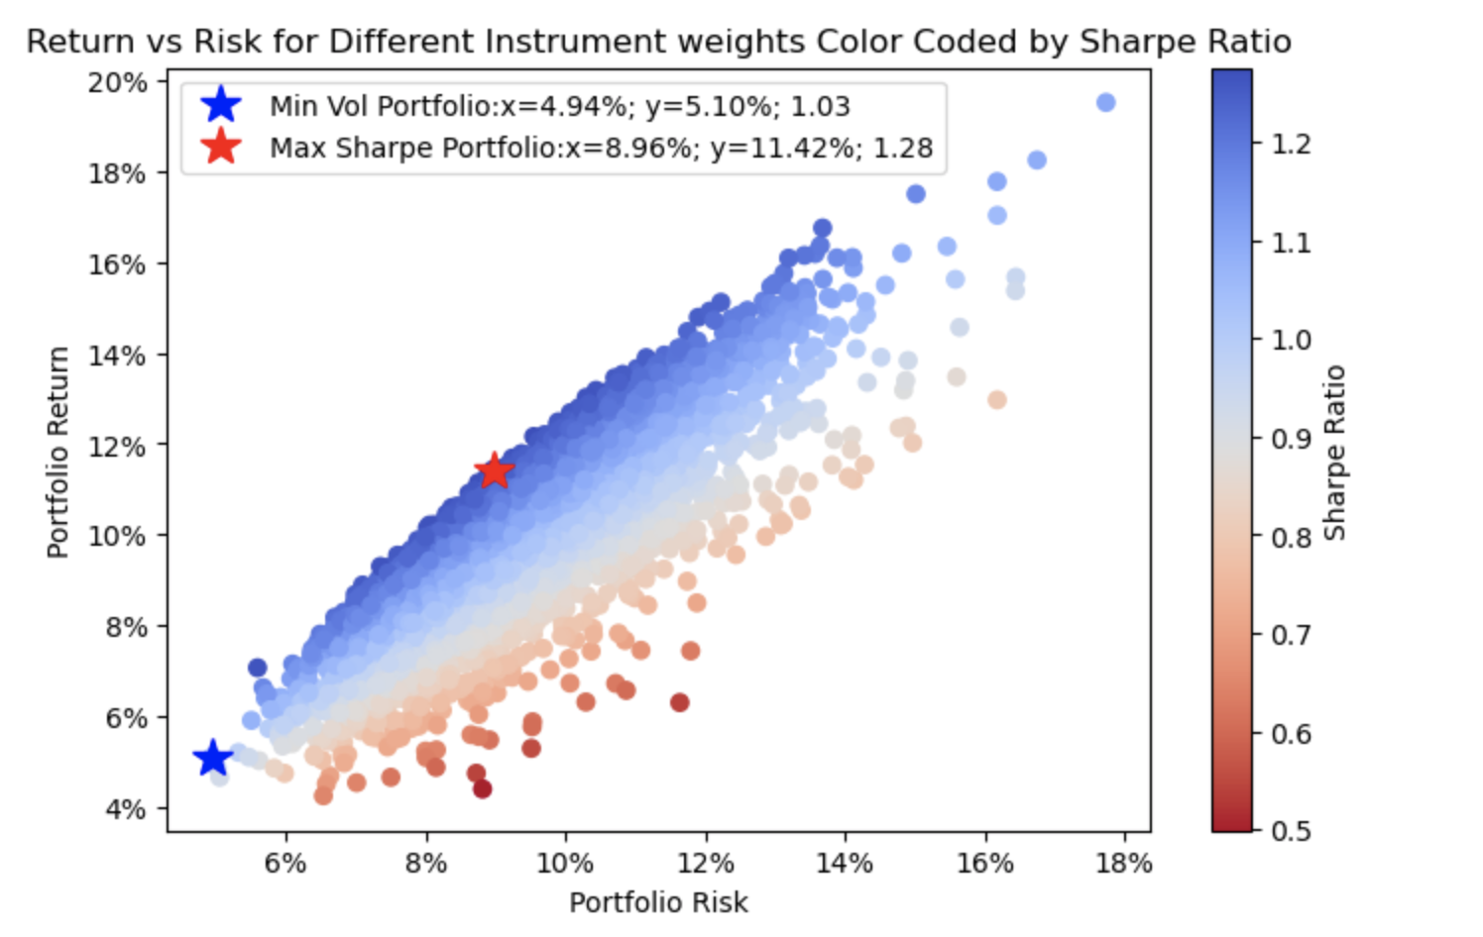
BEST SHARPE PORTFOLIO AND WEIGHTS
Max Sharpe Portfolio Weights
Weights are mostly allocated to AAPL and BOND
Minimum Volume Portfolio Weights
Highest weights associated with EUR, BOND, SPY and GOLD

Slide 16
COMPARISON OF EQUAL-WEIGHTED AND MAXIMUM SHARPE PORTFOLIO
BETA CALCULATION

Slide 17
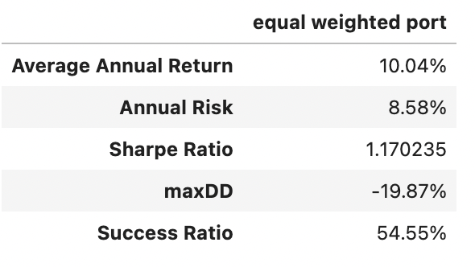
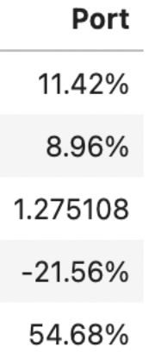
Equal-weighted Portfolio
Sharpe Ratio of equal weighted portfolio is 1.17 which is less than 1.28, the sharpe ratio for Max Sharpe Portfolio.

Slide 18
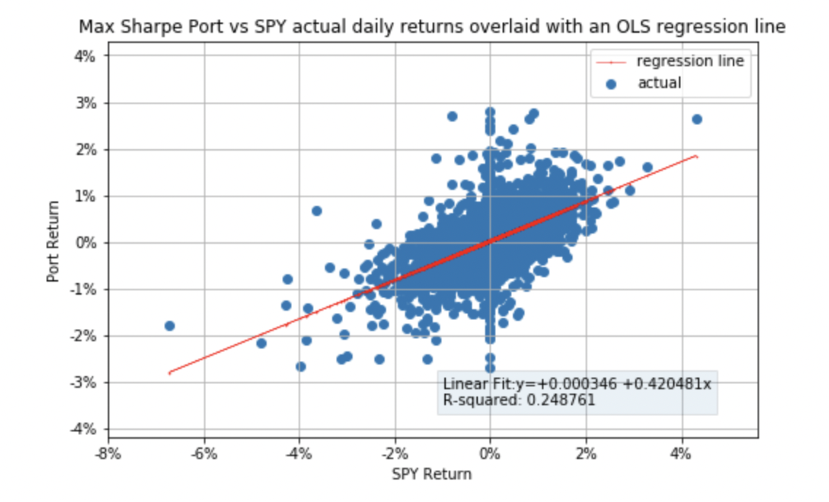
BETA Calculation of maximum Sharpe Portfolio
The beta for the Max Sharpe Portfolio is 0.42

Slide 19
PORTFOLIO COMPARISON AND SUMMARY STATISTICS

Slide 20
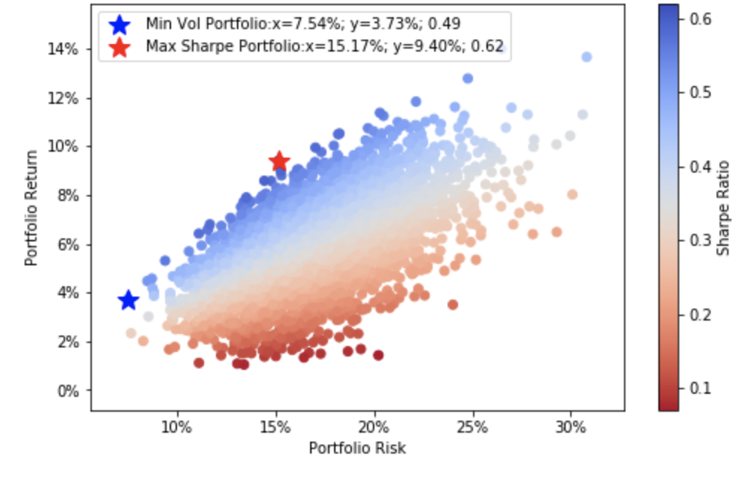
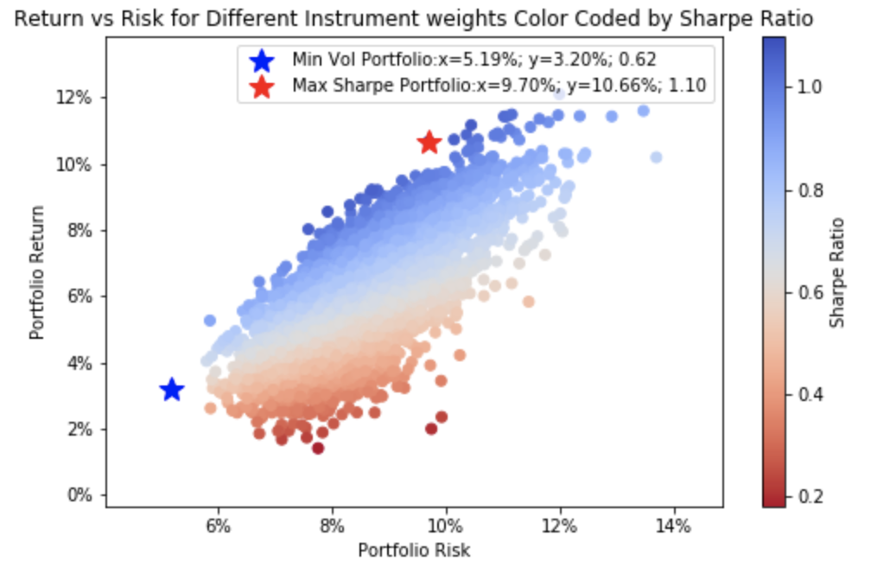
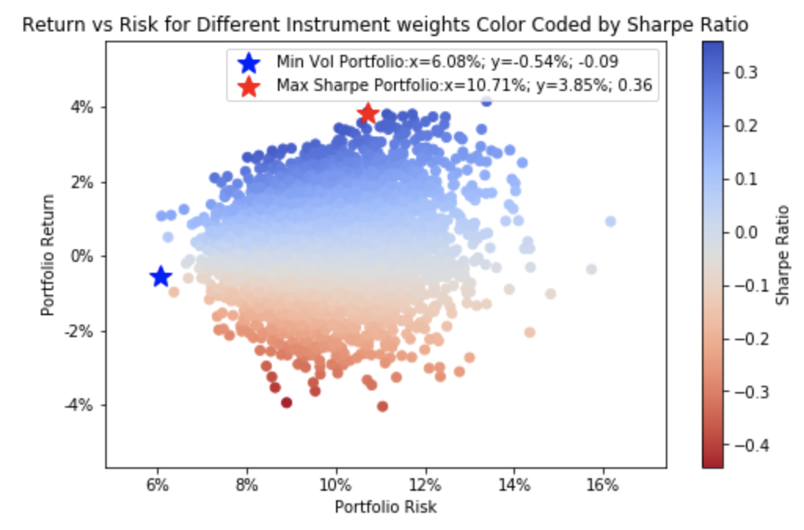
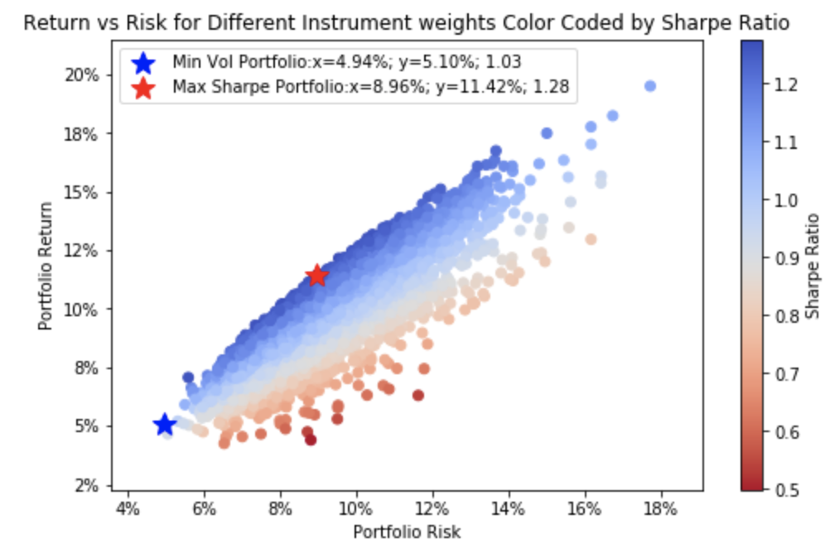
Mean Variance for Frame with Benchmark Instruments
Mean Variance for Frame with MA Strategy for all Instruments
Mean Variance for Frame with BB Strategy for all instruments
Mean Variance for the Best Portfolio

Slide 21
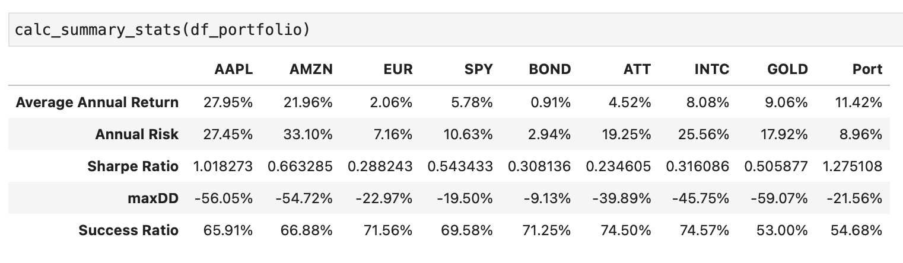
Summary Statistics for the Portfolio
Comparisons…

Slide 22
Thank You!

